Slide 1
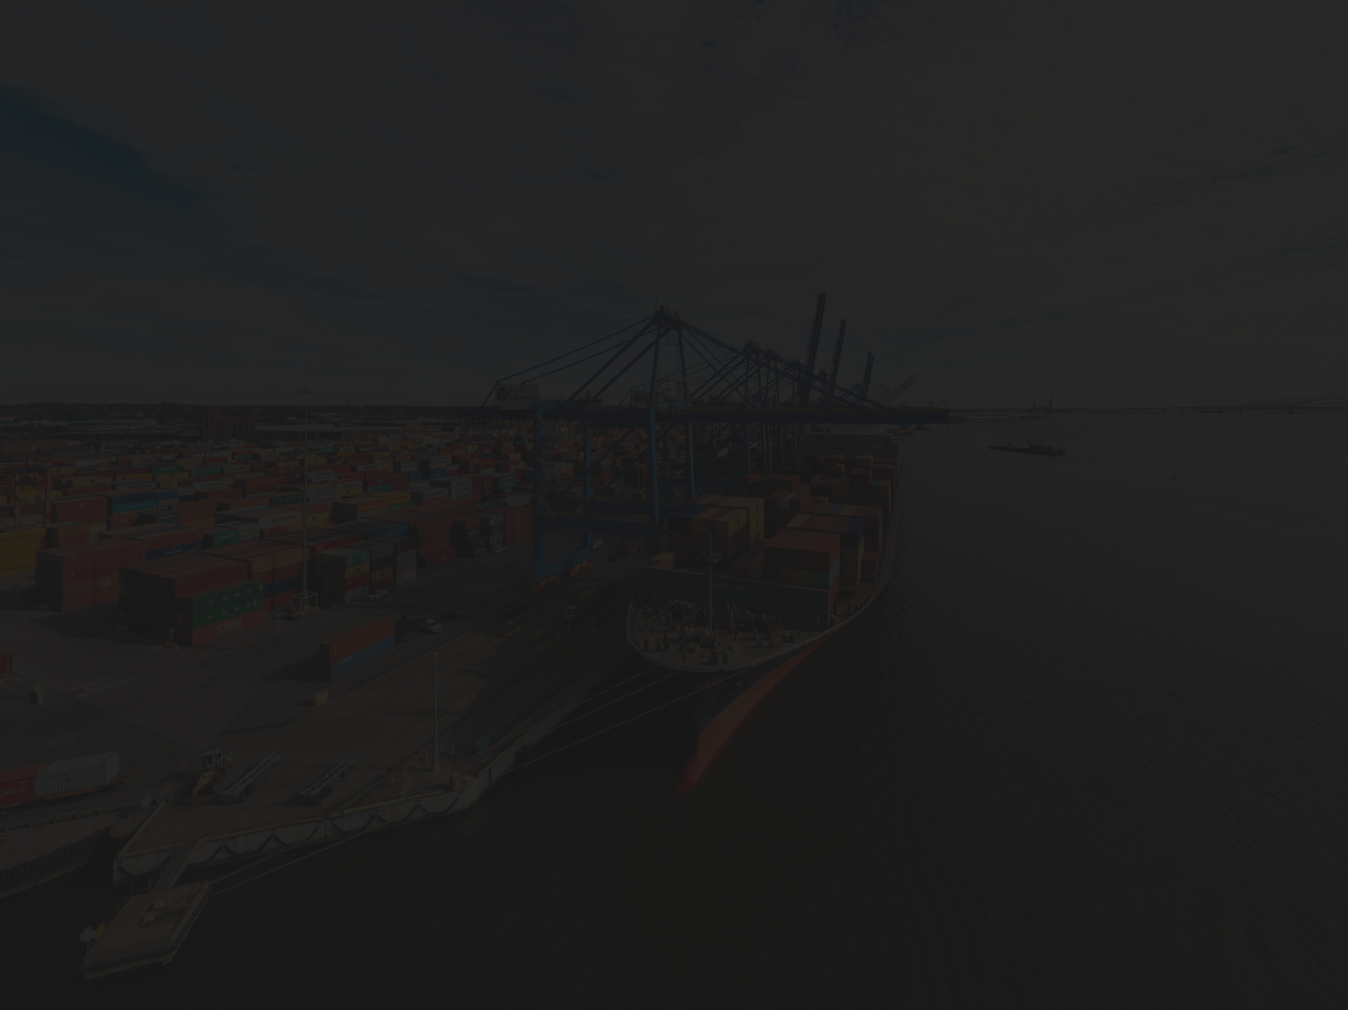



SUPPLY CHAIN
MANAGEMENT
Author: Khush Shah
Guided by: Prof. Reza Jafari
Visualization of Complex Data
Term Project Presentation

Slide 2
CONTENT
Introduction
Dataset
Dash App
Conclusion:
Dataset selection
Dataset Description
Pre-processing
Statistics
Visualizations
Dashboard
Remarks
Future Scope

Slide 3
Introduction: Dataset Selection
Supply chain management: Rising scope in data analytics/science.
Effecient management can help in understanding expenditure and waste product management.
Need to understand the aspects of price, global trade and customer sentiments.

Slide 4
Introduction: Dataset Description
DataCo SMART SUPPLY CHAIN FOR BIG DATA ANALYSIS-Kaggle
Dataset comprises 53 valuable columns and about 100,000 records
Various features like 'Type,' 'Delivery Status,' and 'Order Status' to numerical figures like 'Days for shipping (real),' 'Benefit per order,' and 'Sales per customer'

Slide 5
Dataset: Pre-processing
Removed the redundant columns such as images, feedback etc.
Presence of 11 null or empty values. Eradicated due to the rare presence of it.
Majority of the data has the presence of outlier, also the data was found to be non-Gaussian or non-ideal through Shapiro-Wilk test

Slide 6
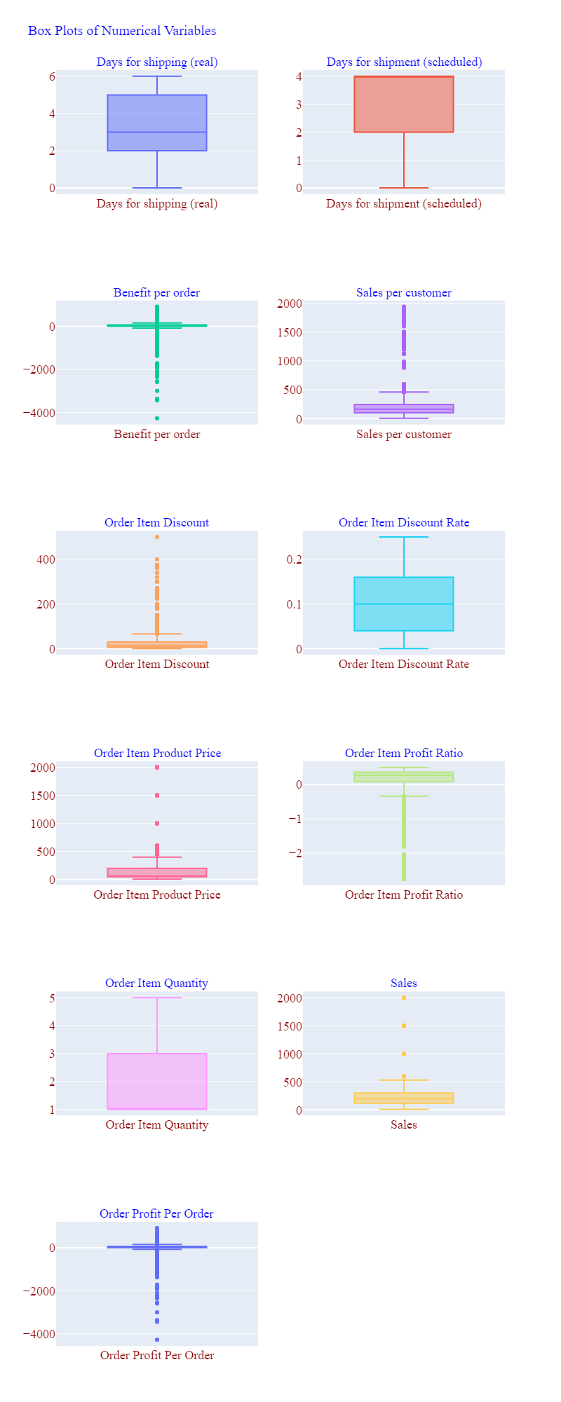
Dataset:
Pre-processing

Slide 7
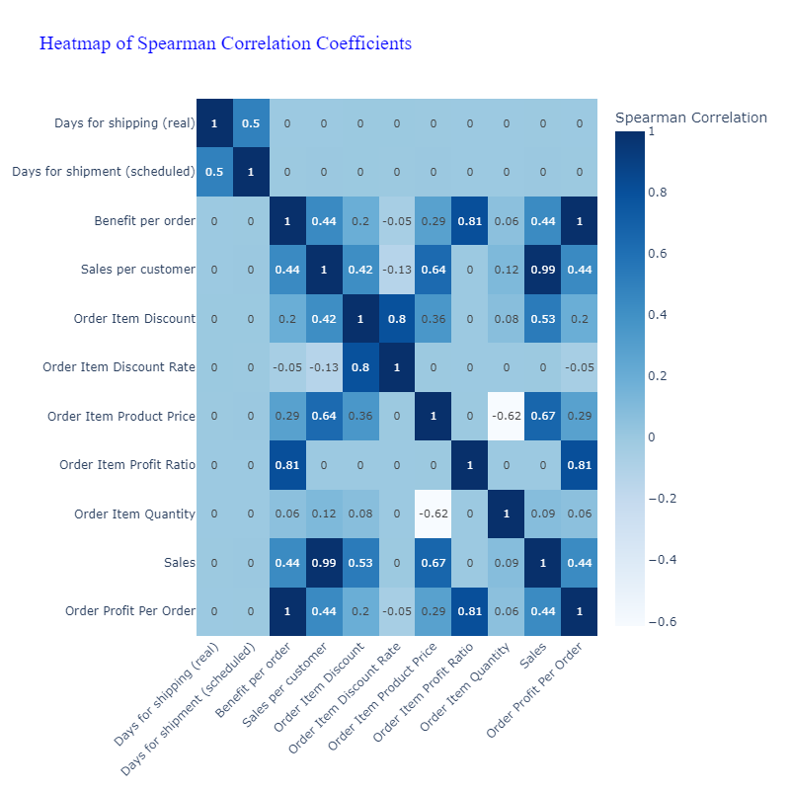
Dataset:
Statistics

Slide 8
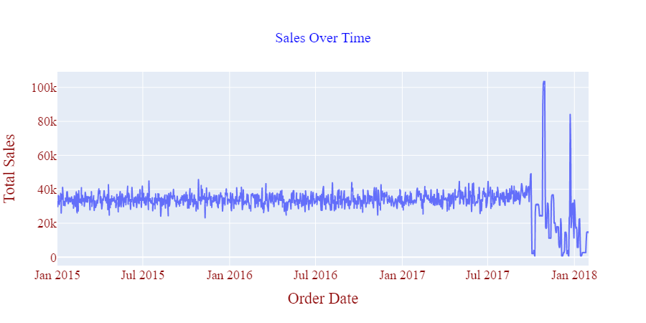
Visualizations

Slide 9
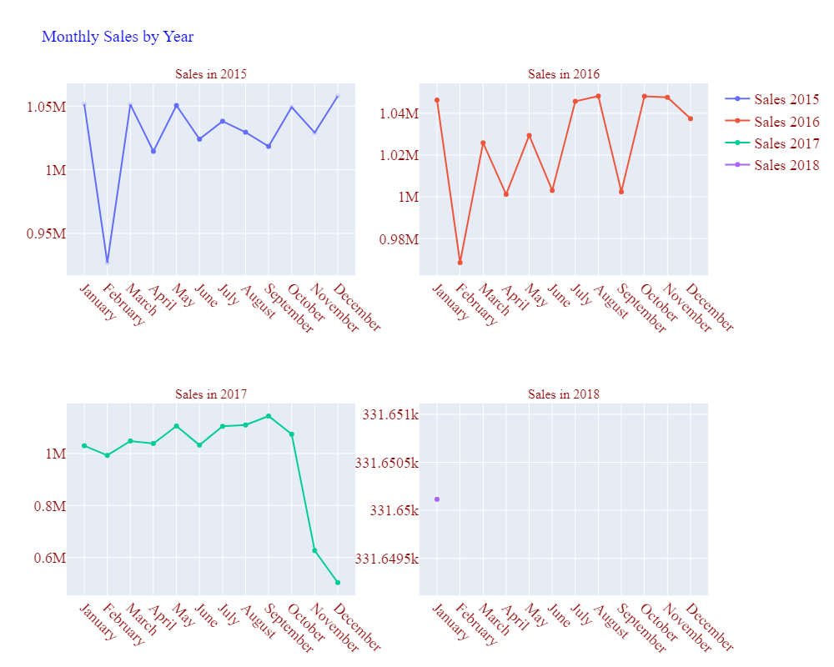
Visualizations

Slide 10
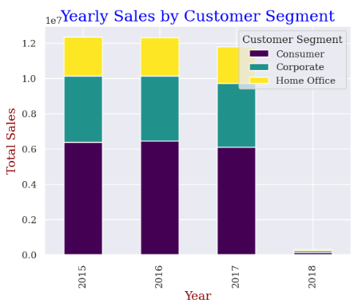
Visualizations

Slide 11
Dash-App
https://dashapp-apj4q4ohfq-ue.a.run.app/

Slide 12
Conclusion: Remarks
Though the number of orders is increasing, multiple losses have been recorded in all the regions, indicating that the more time it takes to deliver a package, the more losses might be recorded.
Certain high-priced products are only sold in a couple of markets, indicating not to push such products where the demand might be very low.
The consumer products are the most sold products indicating the customer sentiments.

Slide 13
Conclusion: Future Scope
Dig deeper in the cost of delivery.
Analyze the pricing strategy of the products and the packaging.
Expand the distribution of products to the regions where there is higher demand.

